Slide 1
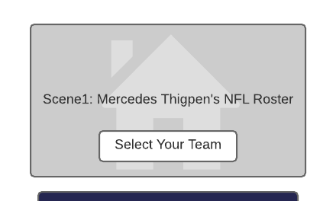


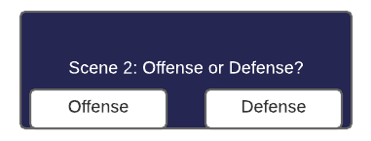


Scene 3: Offense Scene
Scene 4: Defense Scene
Offense
Defense
Go To Defense
Go To Defense
Table including player information. Check box used to select and delete players.
Table including player information. Check box used to select and delete players.
Remove From Roster
Remove From Roster

